Slide 1
Report 12/11/2020
P. Hacker

Slide 2
Previously: 2D Inversion Results
considering a given emissivity profile shape, there exists an ideal set of K factors constraining the ratio of poloidal and radial gradients according to the X² optimisation
not necessarily the same as defined by the lowest 2D deviation and Pearson coefficient, whose optimisation also yields a set of K factors
radial positioning of profiles is subject to the selection of K factors over the radius (and angular space)

Slide 3
Previously: 2D Inversion Results
poloidaly distributed profiles are, so far the data set suggests, the hardest to reconstruct properly (especially on the inboard side)
asymmetric characteristics can be property of the underlying emissivity profile to the tomography, however some are introduced due to the line of sight geometry
combinations of profile shapes, especially poloidaly symmetric and any else become hard to distinguish from one another (see ring and island mimic)

Slide 4
Previously: 2D Inversion Results
bright spots on-/off-axis and, e.g. bright rings can be separated from each other depending on the distance
individual bright sheaths can no longer be reconstructed radially when closer than 0.2m
reconstructions of forward calculated STRAHL simulations are largely accurate in position and value
reference XP 20181010.032 difficult to reconstruct, subject to difference in forward and backward model?

Slide 5
QSB LabVIEW Routine Review (see CHANGELOG.md)
PROS
added EPOCH timer to UI, timing mode that calculates EPOCH time at start
added T1-T4 timing input to UI, added T0-T1 timer to UI (should at least be 30s)
fixed wrong time base in calibration procedure
DAC range setting file load or input via the UI
selected channel feedback output, though with delay >10ms (single/multi channel)
performance for 1-10 selected channels in feedback is fine
overhaul of calibration parameter routines since detector response is more complex than a single peak and exponential decay
full P_rad routine added for after the data acquisition to access power loss quickly (same as IDL/python)
filter register settings fixed to match sample timings in milliseconds
improved/implemented local-storage-mode-only, so no crash at upload
upload of error corrected voltage input to archive as well (same as IDL/Python)

Slide 6
QSB LabVIEW Routine Review (see CHANGELOG.md)
CONS
DAQ routine now more prone to crashing, hiccups and slow processing causing sample timing errors
ADC bit settings not fully understood, potentially not intended setting here (wrong documentation?)
crashing with bad device status at memory overflow or uncompleted DAQ/upload, incosistent to recover
hardware needs warm-up time of ~30min (before?)
some small fixes needed to improve quality-of-life experience during experimental campaign (dials not working as intended, …)

Slide 7
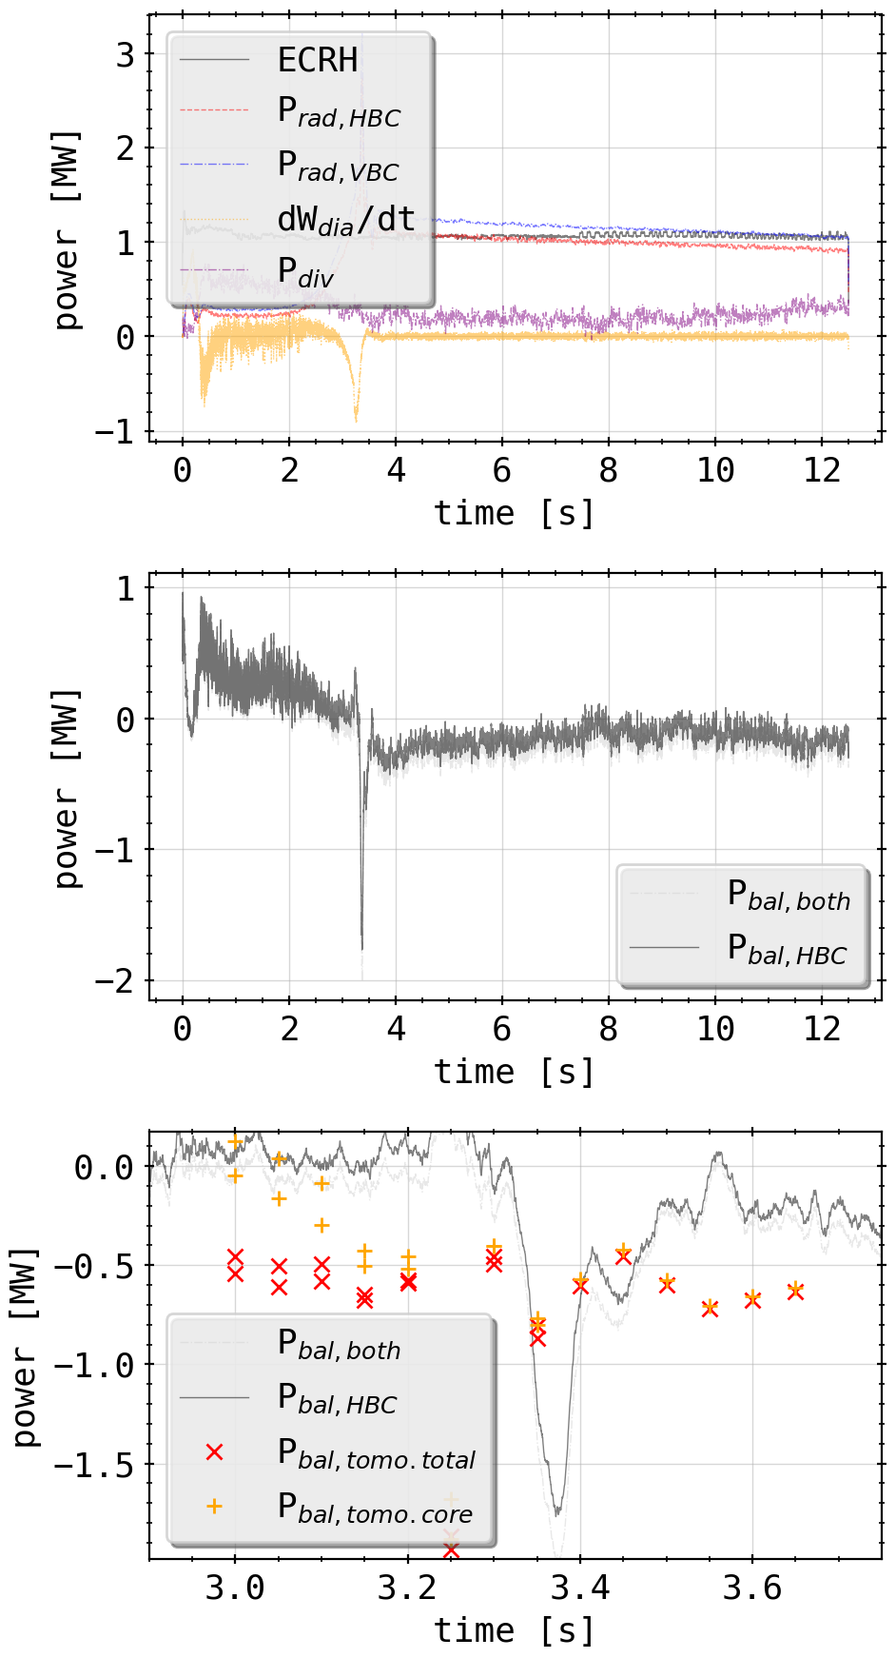
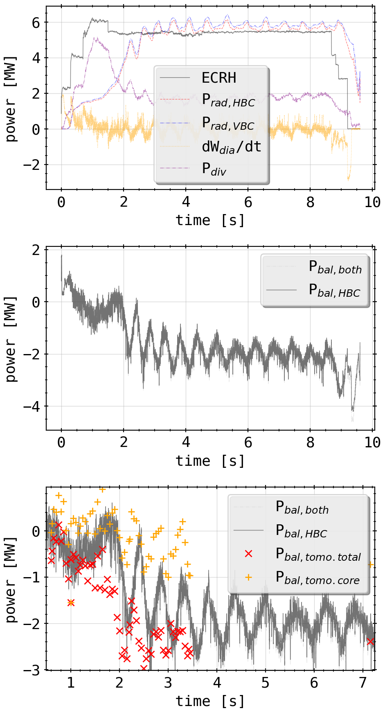
Tomogram Statistics: Experiment Power Balance
compiled experiment data and parameters to calculate
also exchanged radiated power proxy from bolometer camera by 2D integrated power of tomogram (both core and total)
20180725.044
20181010.032

Slide 8
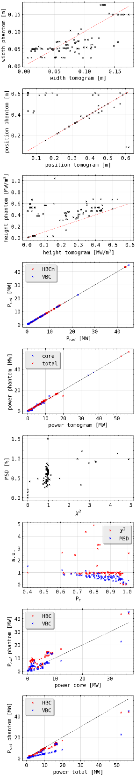
Tomogram Statistics: Phantom Reconstructions
radial profile positioning good, though width and height have small to large deviations
peak height comparison exhibits offset on phantom side: widened radial shape and longer decays (width)
P_rad and total/core power values match very well for phantom reconstructions
a slightly larger range of MSD values yields a ‘good’ X² of ~1.0
there seems to be an offset of MSD about 0.25% (minimum error between source and target to be expected?)

Slide 9
Tomogram Statistics: Phantom Reconstructions
MSD approaches 0.0 if pearson coefficient reaches 1.0, as expected, while X² is around 1.0
P_rad over core/total 2D integrated power yield constant offsets and slopes
core power matches P_rad vor VBC(?) though is lower for HBCm as expected
total power is larger for both P_rad estimates, though with different proportionalities

Slide 10
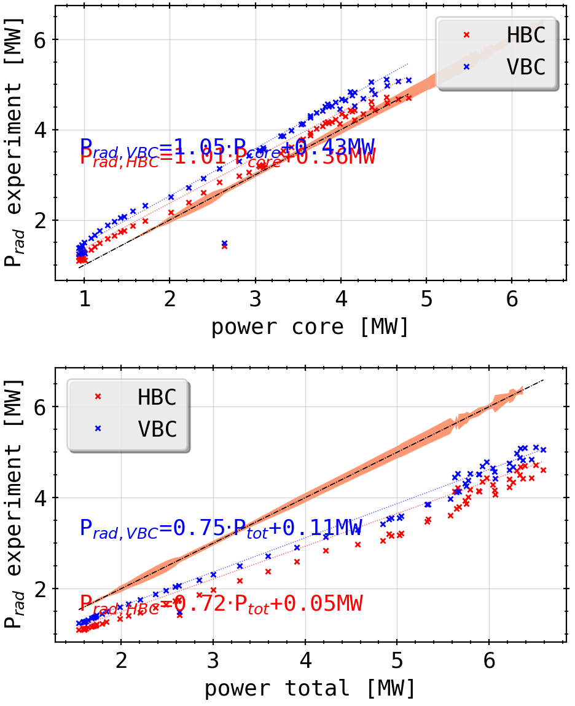
Tomogram Statistics: Experiment Reconstructions Errorbar
20181010.032
extra slope in P_rad vs. total power by cutting negative results from reconstruction when limiting to only physically meaningful numbers (P/m³>0)?
increase of their impact is expected with overall higher radiation level to counteract errors in chordal profile
impact of mathematical error is negligible across the power spectrum, but why?
fit of integrated power values vs camera proxy yields interesting results (~0.4MW offset to core power, ~0.75 ratio to total 2D power)
CONCLUSION

Slide 11
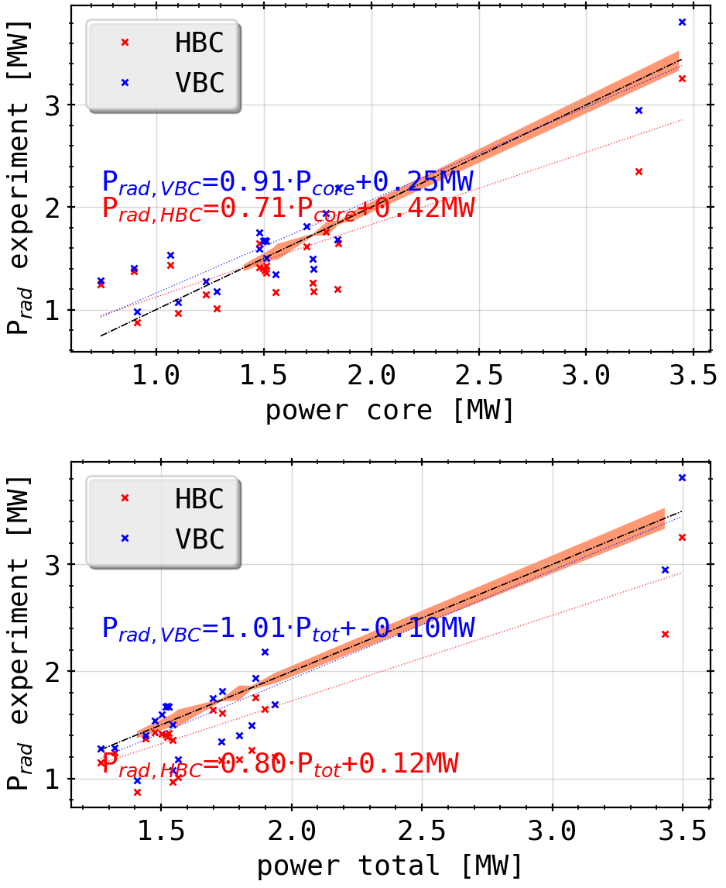
Tomogram Statistics: Experiment Reconstructions Errorbar
20180725.044
extra slope in P_rad vs. total power by cutting negative results from reconstruction when limiting to only physically meaningful numbers (P/m³>0)?
increase of their impact is expected with overall higher radiation level to counteract errors in chordal profile
impact of mathematical error is negligible across the power spectrum, but why?
fit of integrated power values vs camera proxy yields interesting results (~0.4MW offset to core power, ~0.7 ratio to total 2D power)
changes for different discharge types?
CONCLUSION

Slide 12
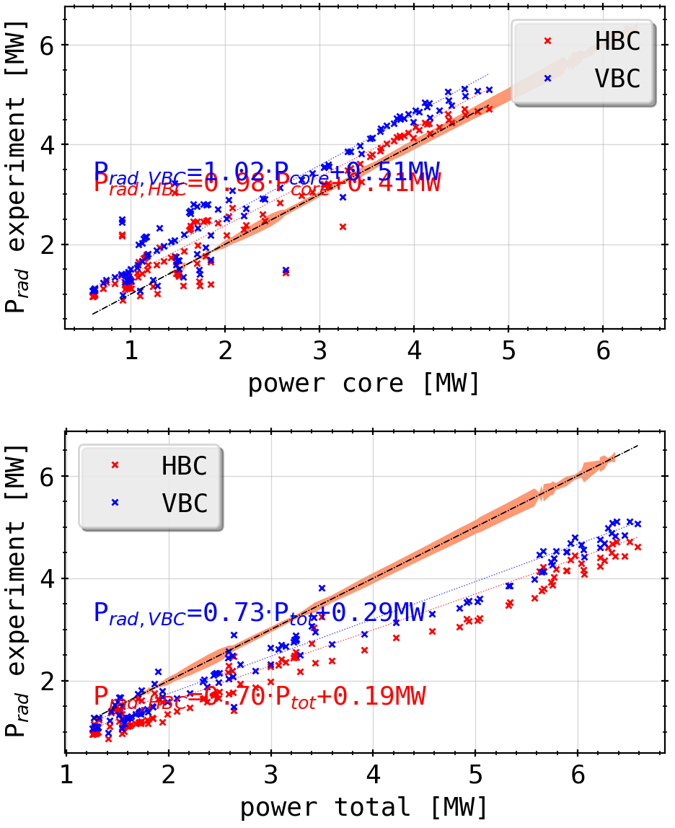
Tomogram Statistics: Experiment Reconstructions Errorbar
(combined)
extra slope in P_rad vs. total power by cutting negative results from reconstruction when limiting to only physically meaningful numbers (P/m³>0)?
increase of their impact is expected with overall higher radiation level to counteract errors in chordal profile
impact of mathematical error is negligible across the power spectrum, but why?
fit of integrated power values vs camera proxy yields interesting results (~0.4MW offset to core power, ~0.7 ratio to total 2D power)
changes for different discharge types?
CONCLUSION

Slide 13
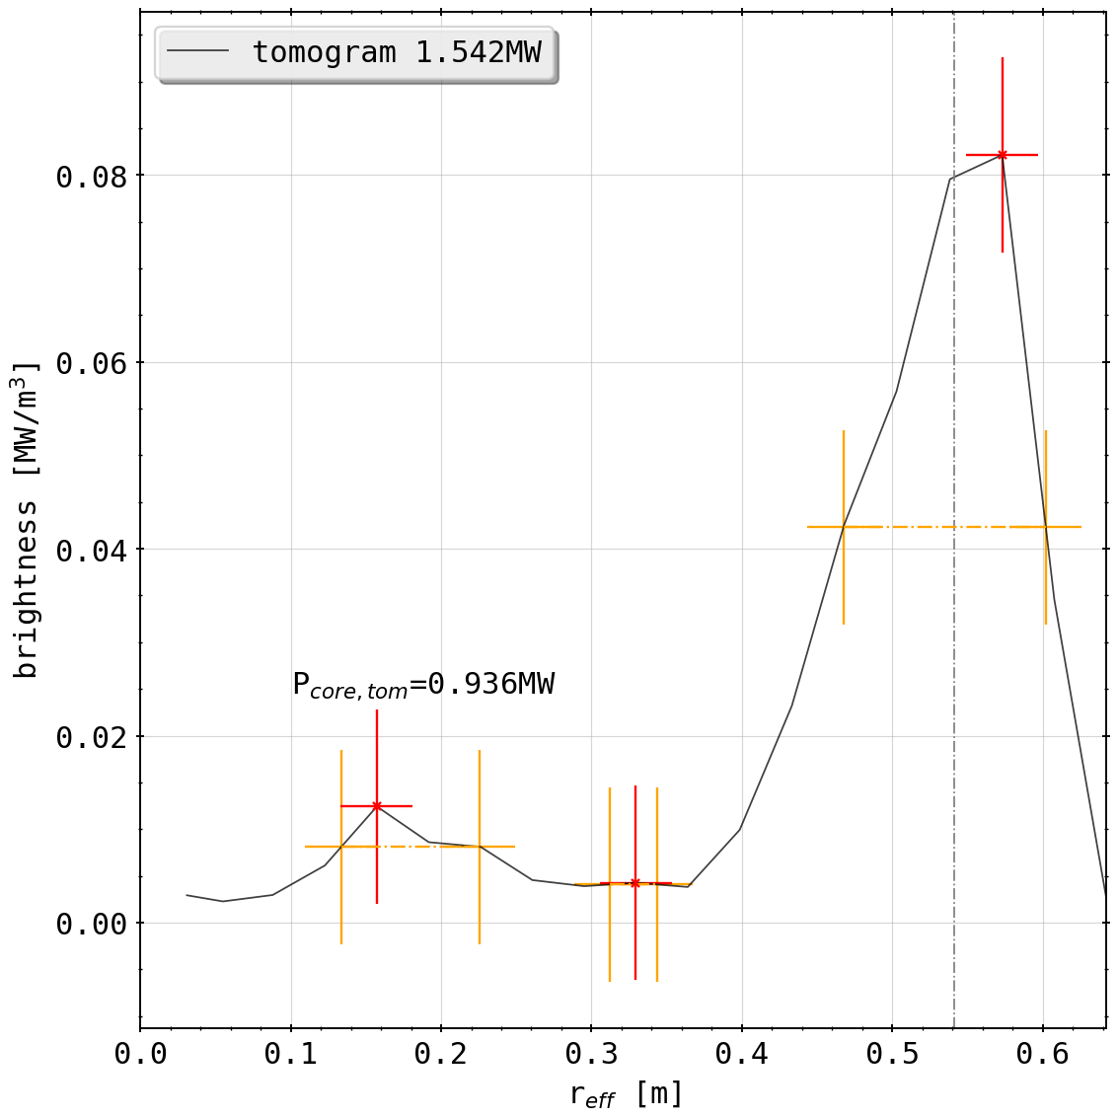
Tomogram Statistics: Experiment Reconstructions Errorbar
20180725.044@3.45s
errorbar looks large here, because the total error for the tomogram (minimum value < 0.0 can be single cell or whole ‘ring’) has to assumed possible at every integration point
e.g.: at powers (all X²~1.0)
total: 5.78 MW , neg: 66.63 kW
total: 6.33 MW, neg: 61.68 kW
total: 2.37 MW, neg: 121.51 kW

Slide 14
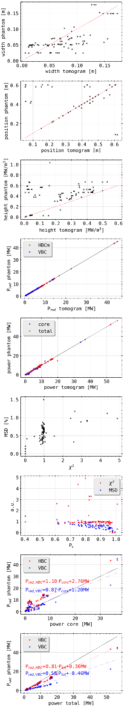
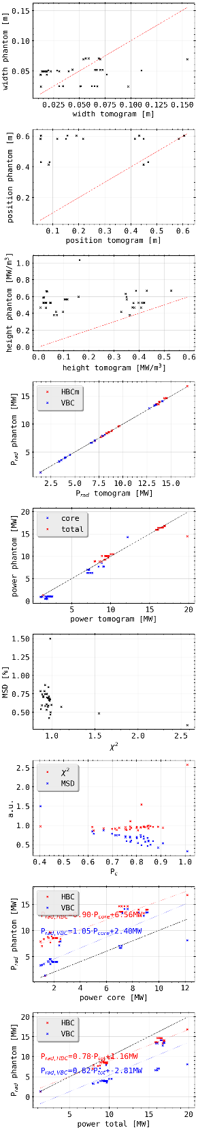
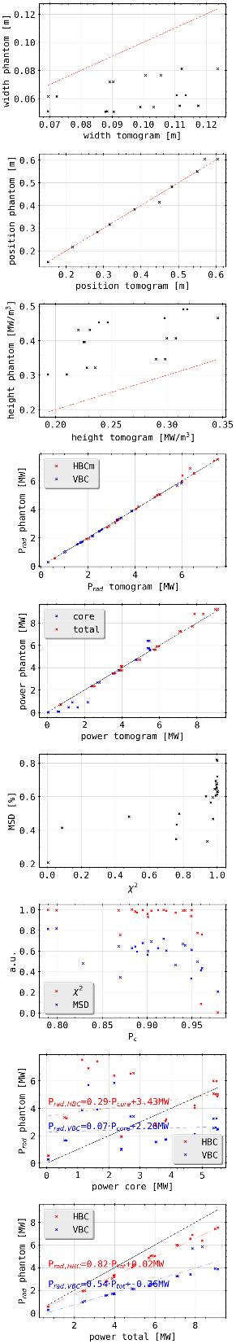
Tomogram Statistics: Phantom Reconstructions
(all phantoms)
(island mimics)
(radiation ring)

Slide 15
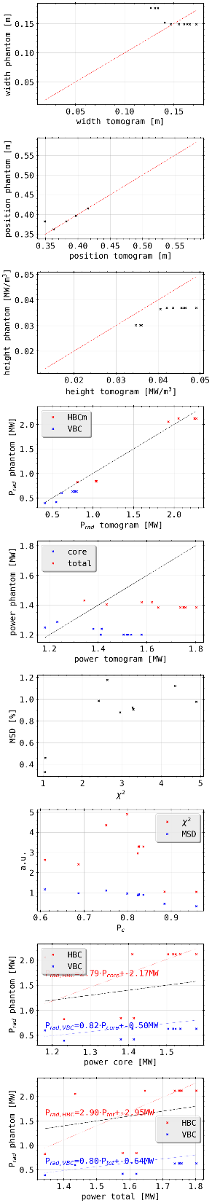
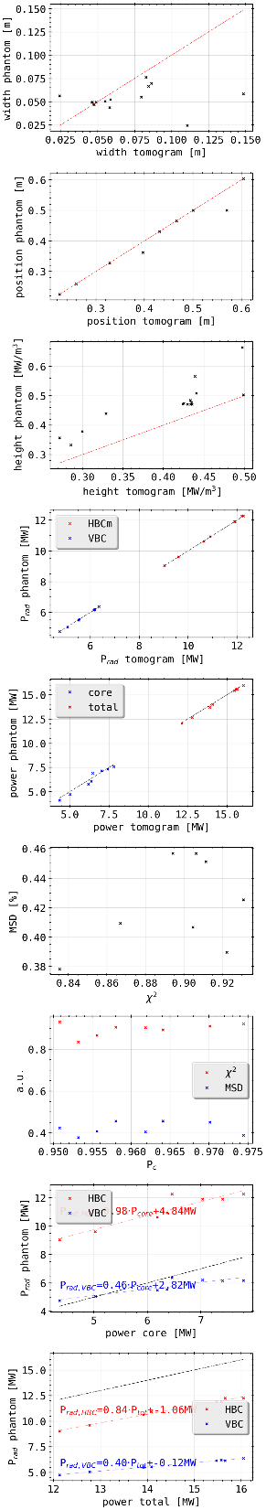
Tomogram Statistics: Phantom Reconstructions
(all phantoms)
(radiation spot)
(double ring)

Slide 16
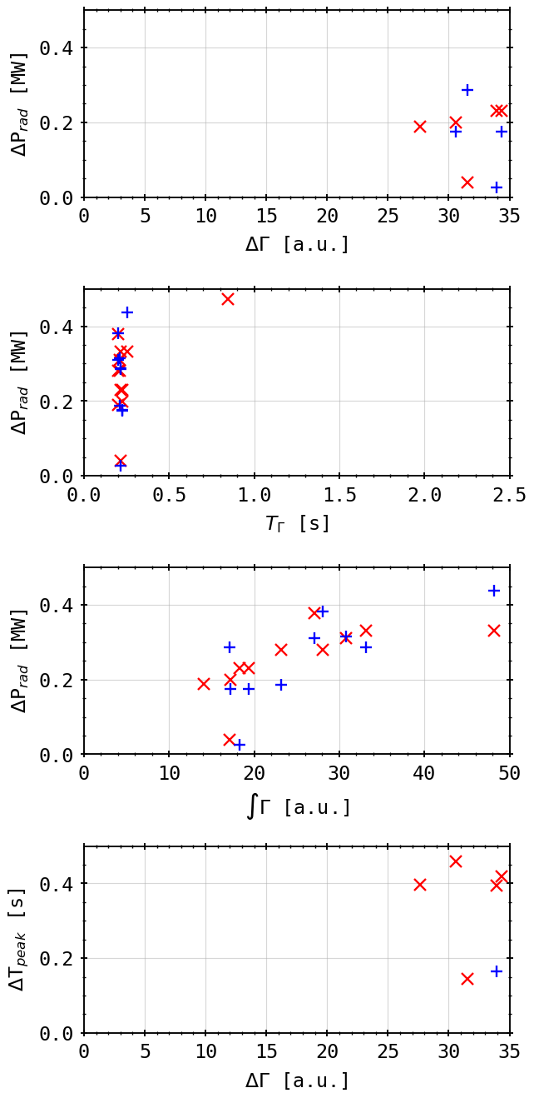
Peak Database: Plasma Parameters
results only shown for the feedback controlled discharge XPID 20181010.032
used feed-forward and density control on the main gas valves and the thermal gas valve for radiation loss feedback (H2)
‘fix’ temporal reaction delay of 200ms
linear correlation between puff and radiation reaction:

Slide 17
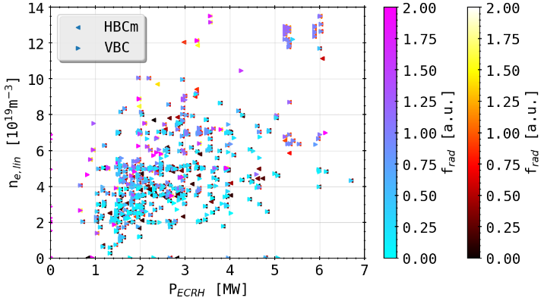
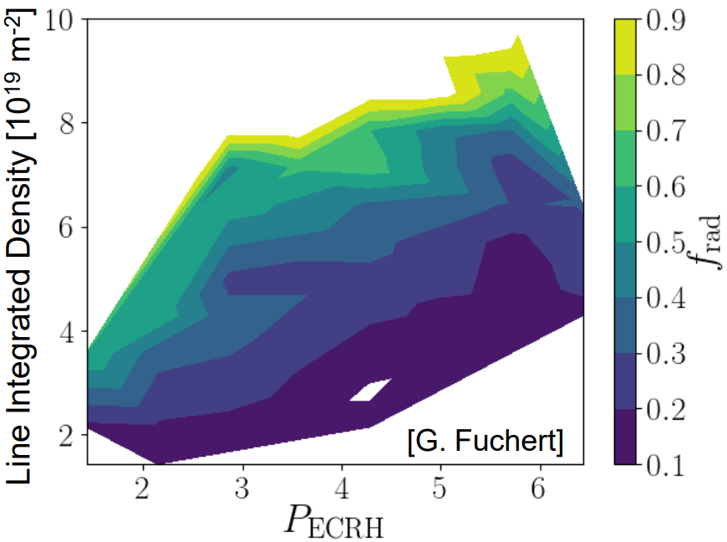
Peak Database: Plasma Parameters
ordering?
expecting underlying order of plasma parameters (density, power and exhaust, i.e. energy confinement time)
further refinement needed: W_dia filtering and confinement time ordering? how when looking at transient phases of gas puff feedback

Slide 18
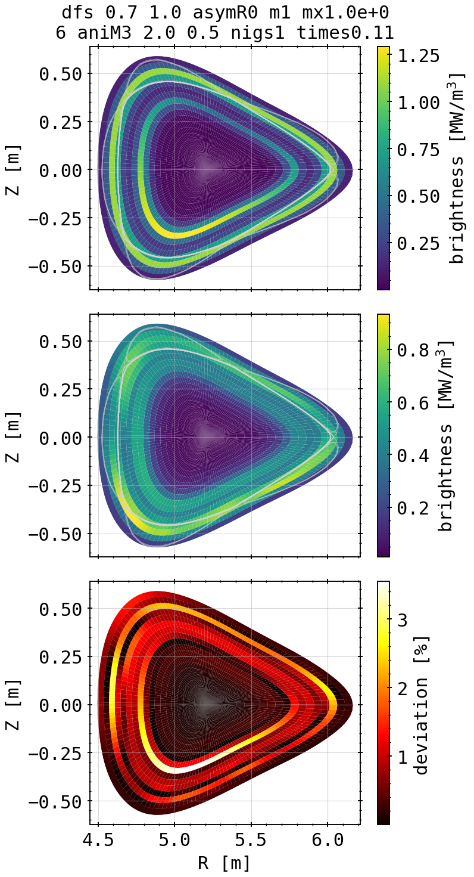
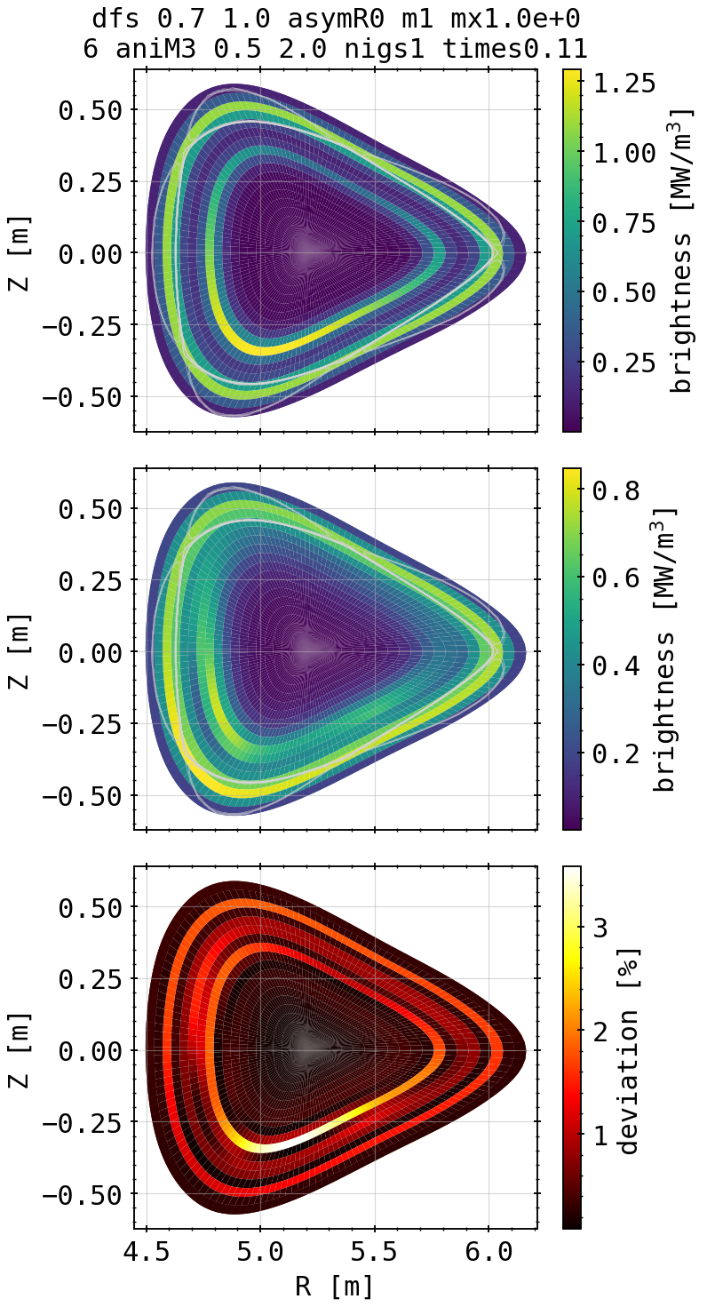
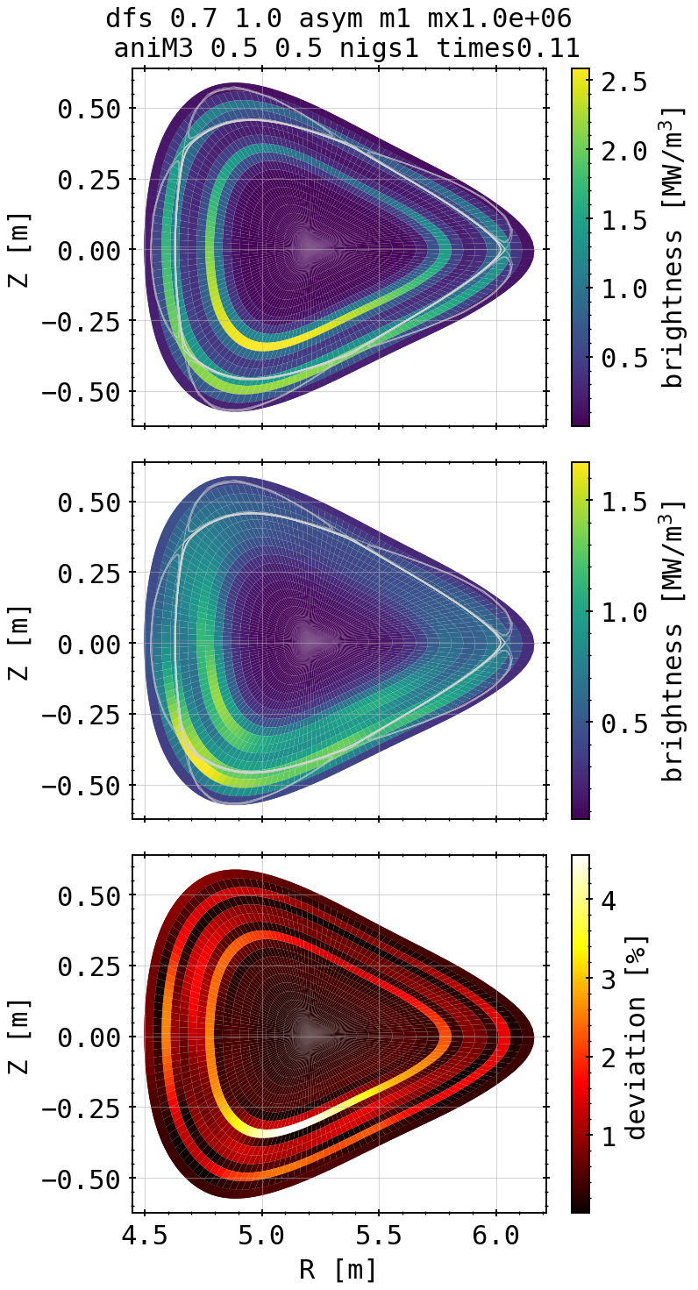
Asymmetry Propagation: Phantoms
inside asymmetry, assuming symmetry
inside asymmetry, assuming asymmetry
outside & inside asymmetry,
assuming asymmetry

Slide 19
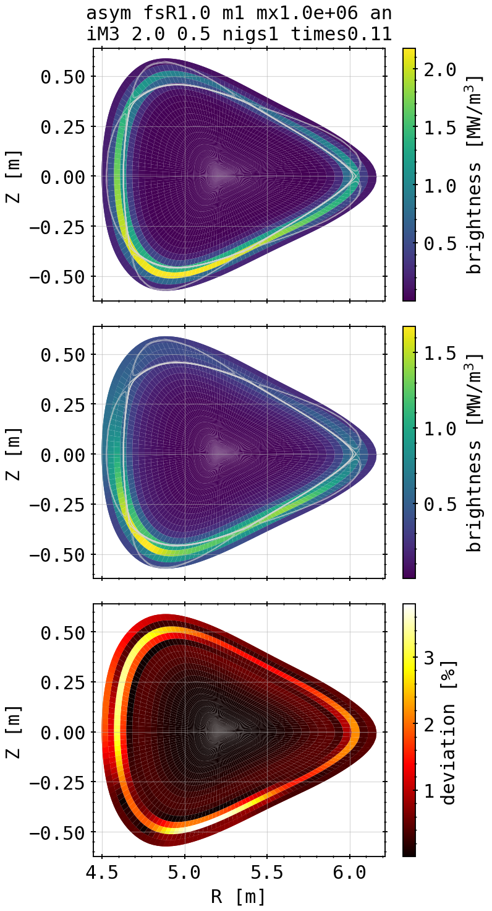
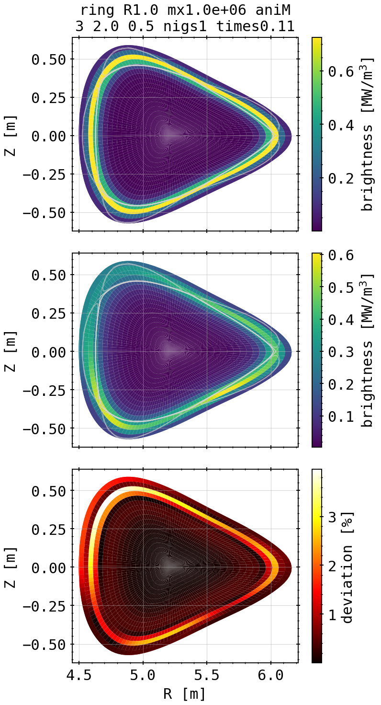
Asymmetry Propagation: Phantoms
outside asymmetry, assuming asymmetry
outside symmetry, assuming asymmetry

Slide 20
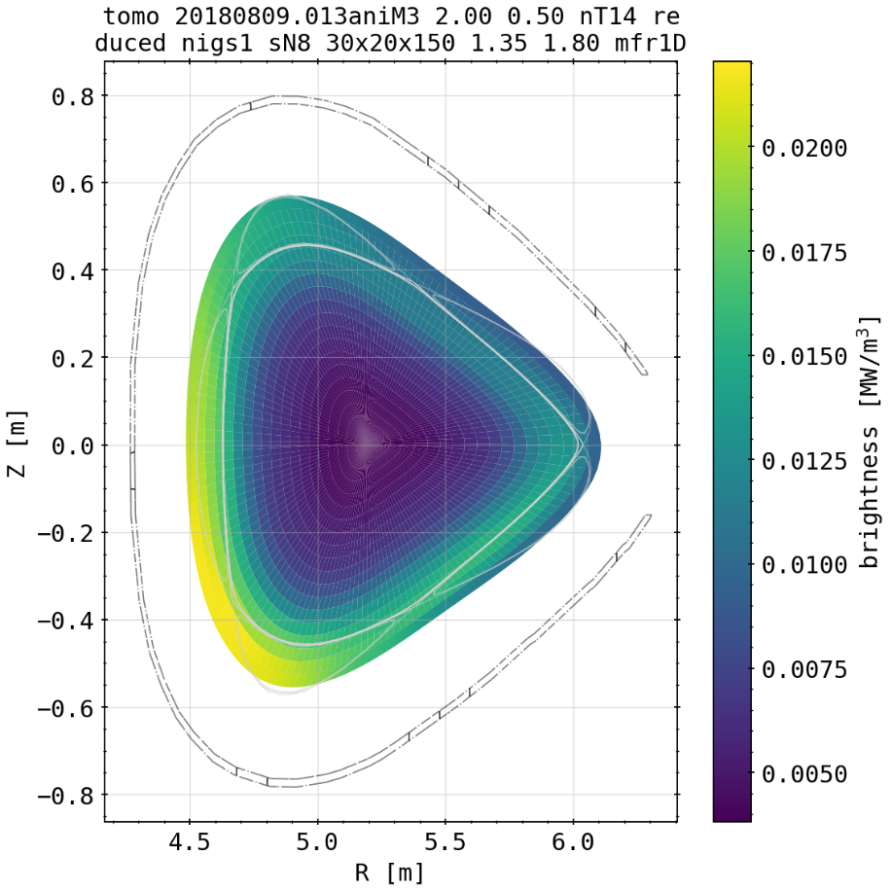
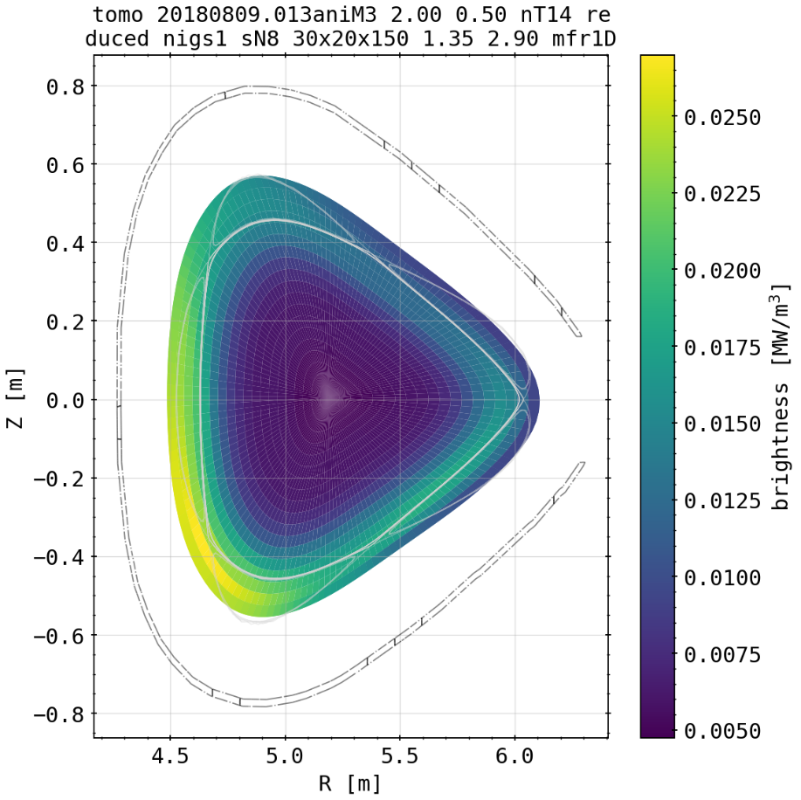
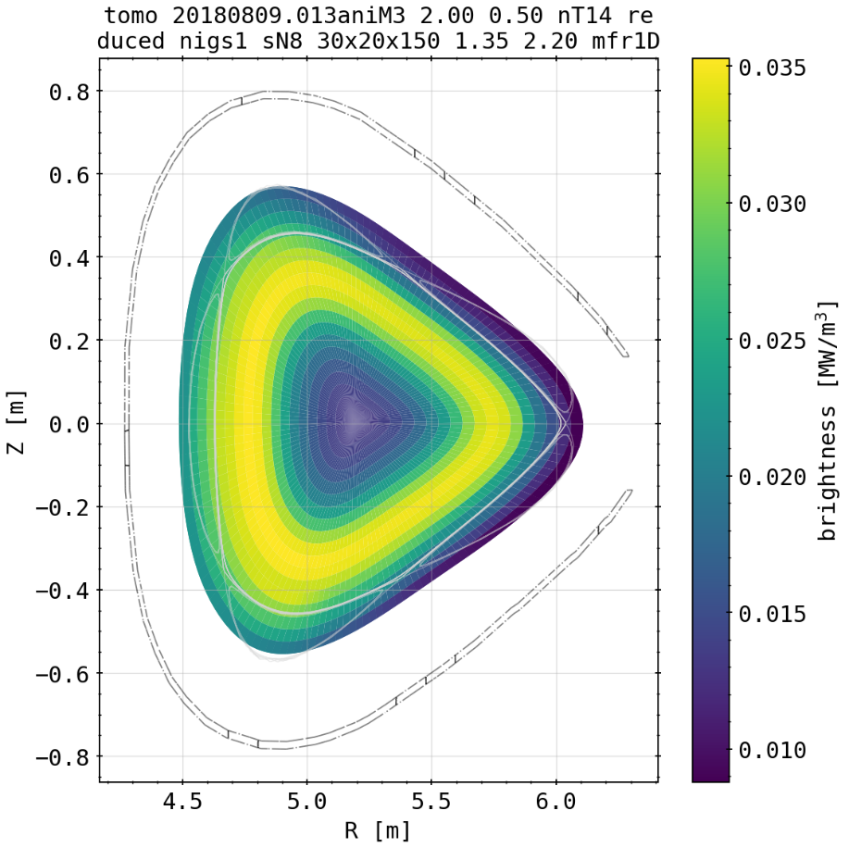
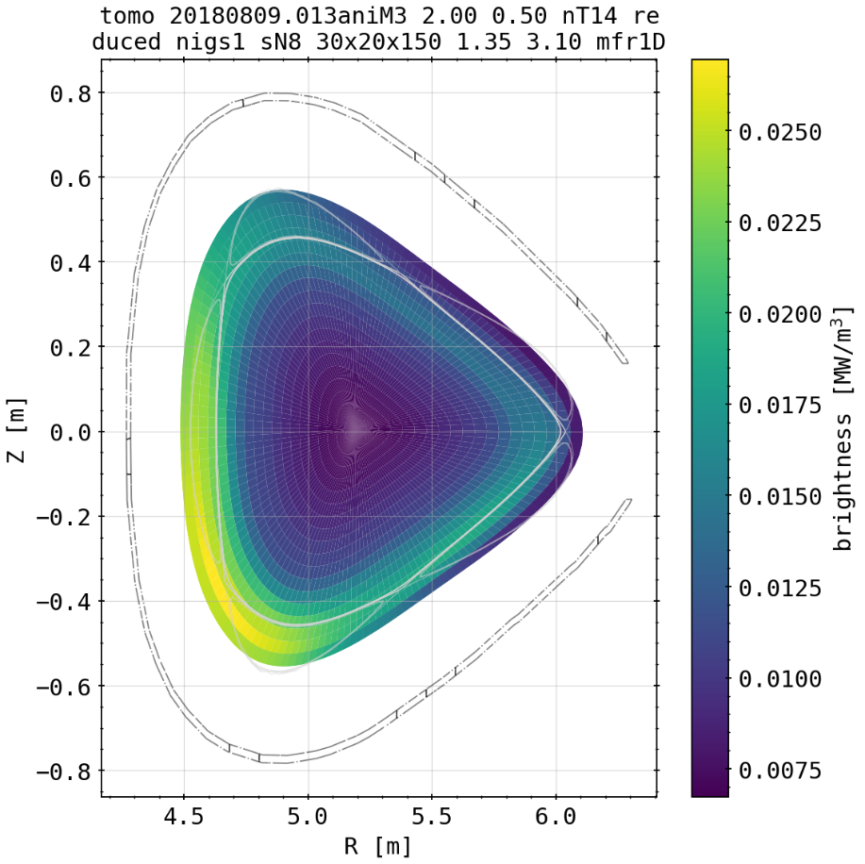
Asymmetry Propagation: 20180809.013
(core symmetric, SOL asymmetric)

Slide 21


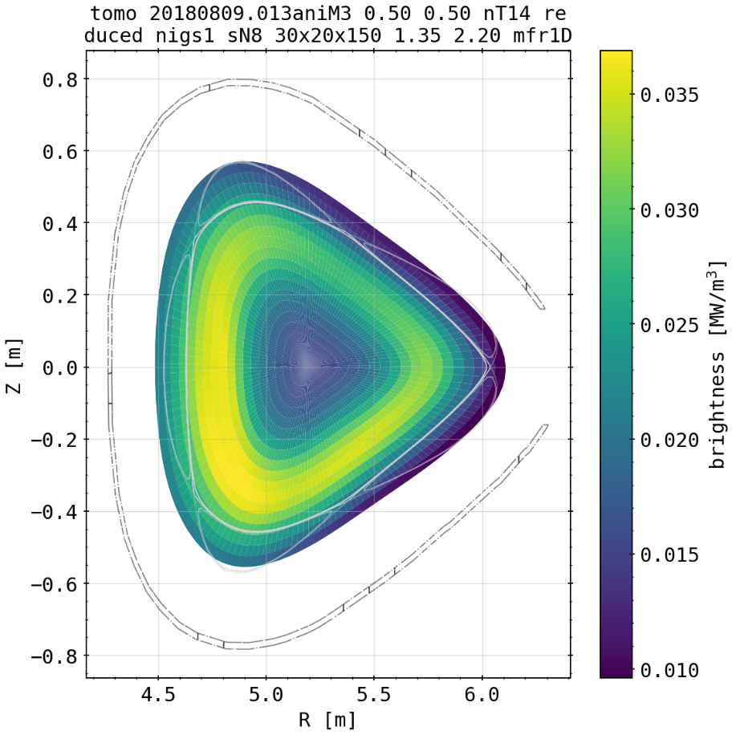
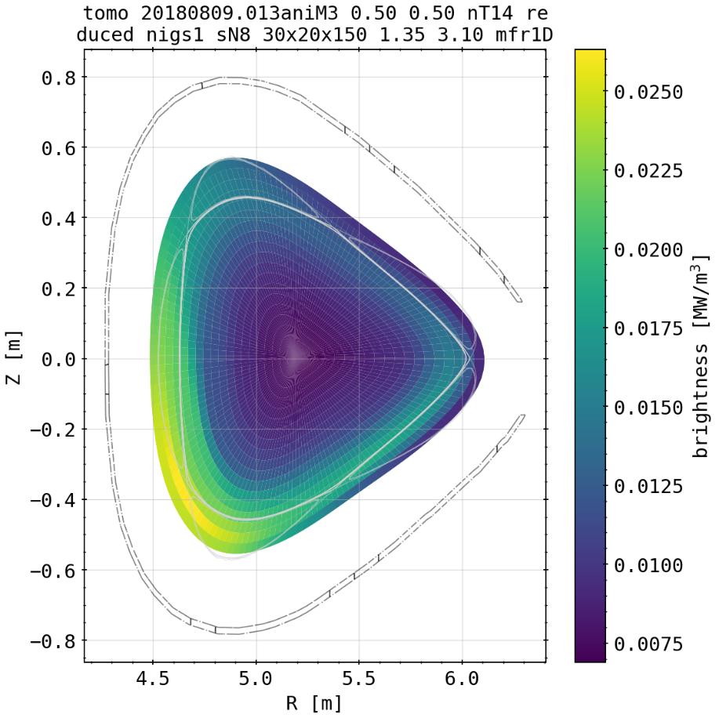
Asymmetry Propagation: 20180809.013
(core symmetric, SOL asymmetric)

Slide 22
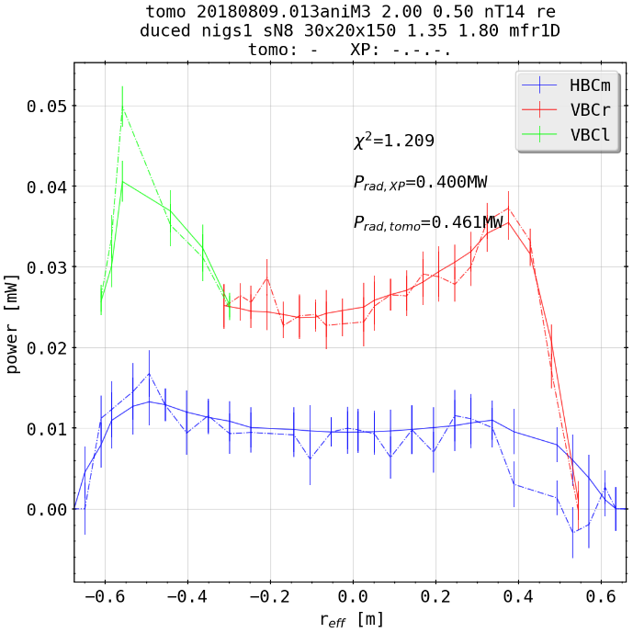
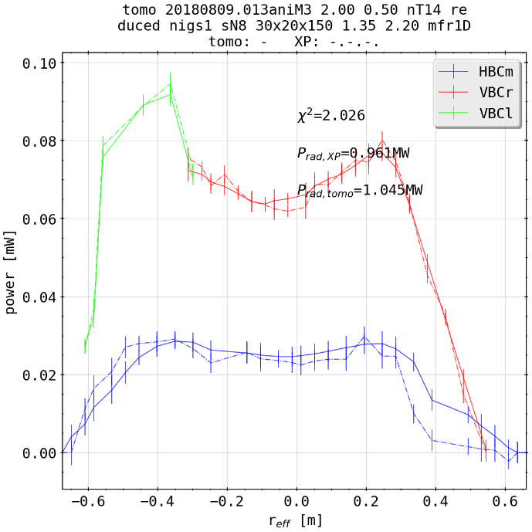
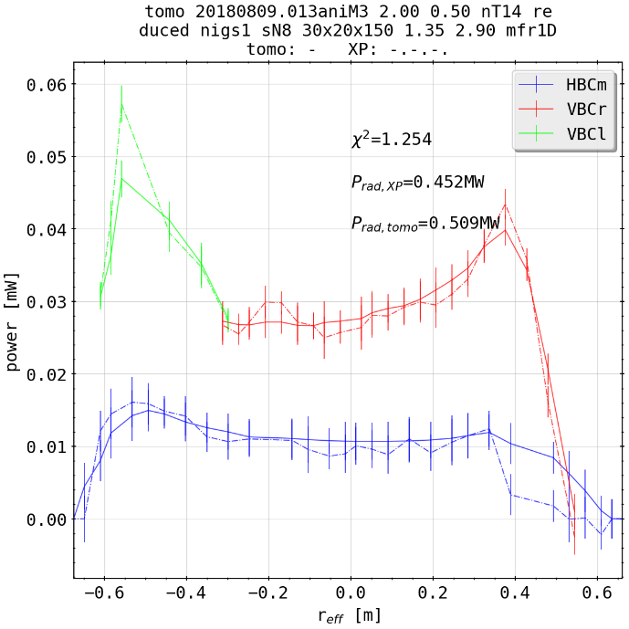
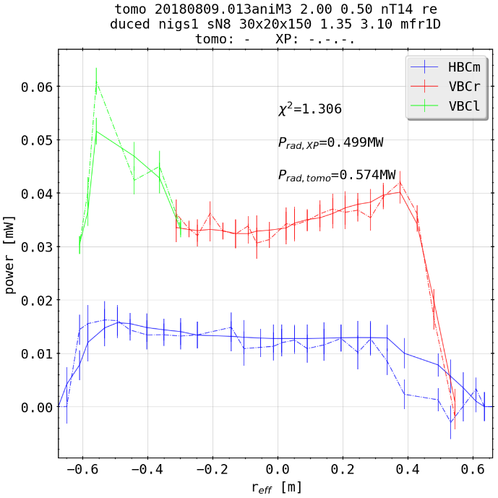
Asymmetry Propagation: 20180809.013
(core symmetric, SOL asymmetric)

Slide 23



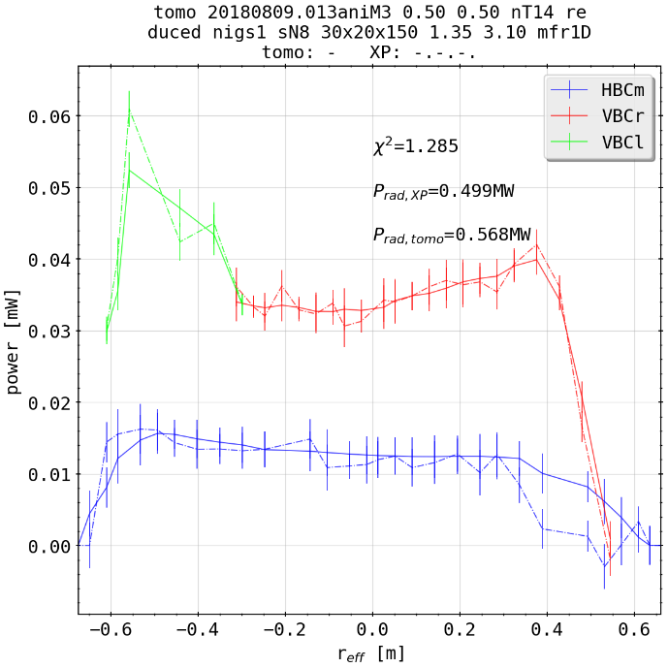
Asymmetry Propagation: 20180809.013
(core asymmetric, SOL asymmetric)

Slide 24
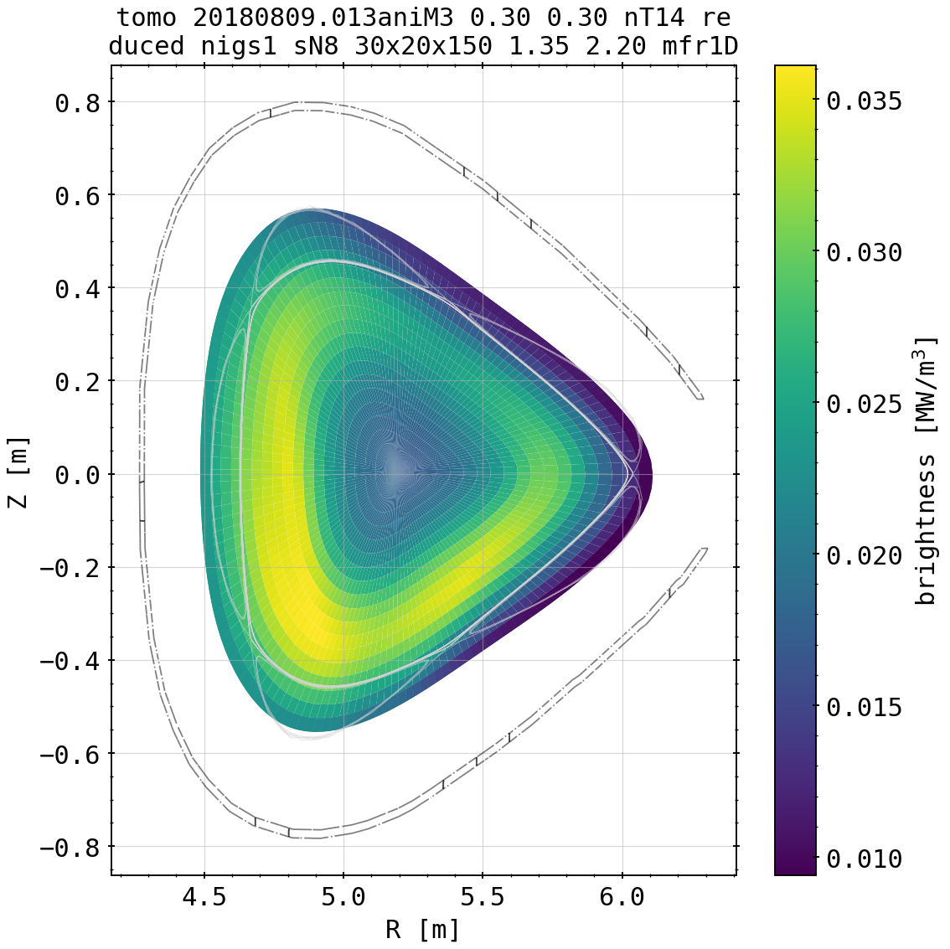

Asymmetry Propagation: 20180809.013
(core asymmetric, SOL asymmetric)

Slide 25
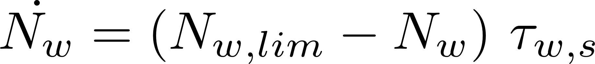
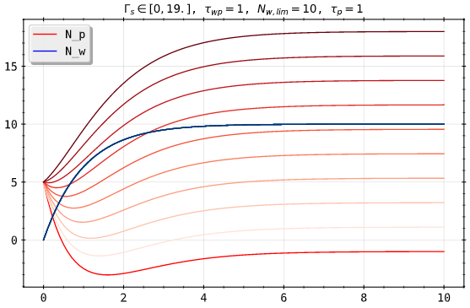
Impurity Seeding: Multi Chamber Model
two chamber model:
P
W
seeding
pumping

Slide 26
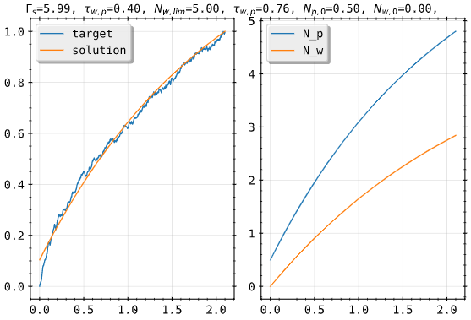
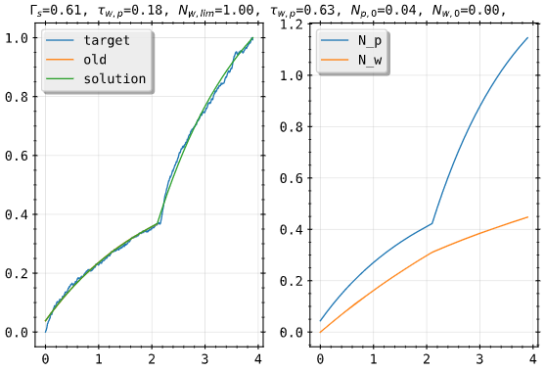
Impurity Seeding: Multi Chamber Model
two chamber model:
20180920.49

Slide 27
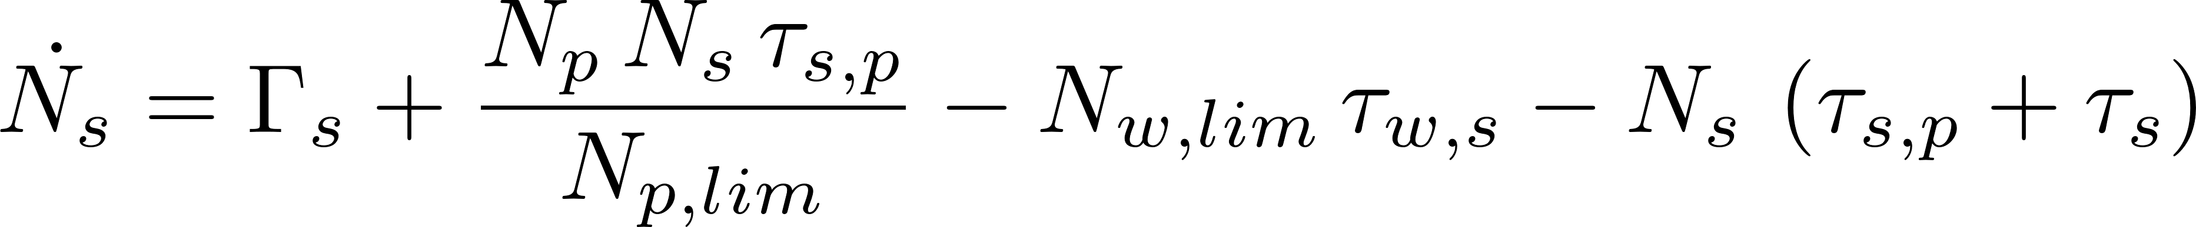
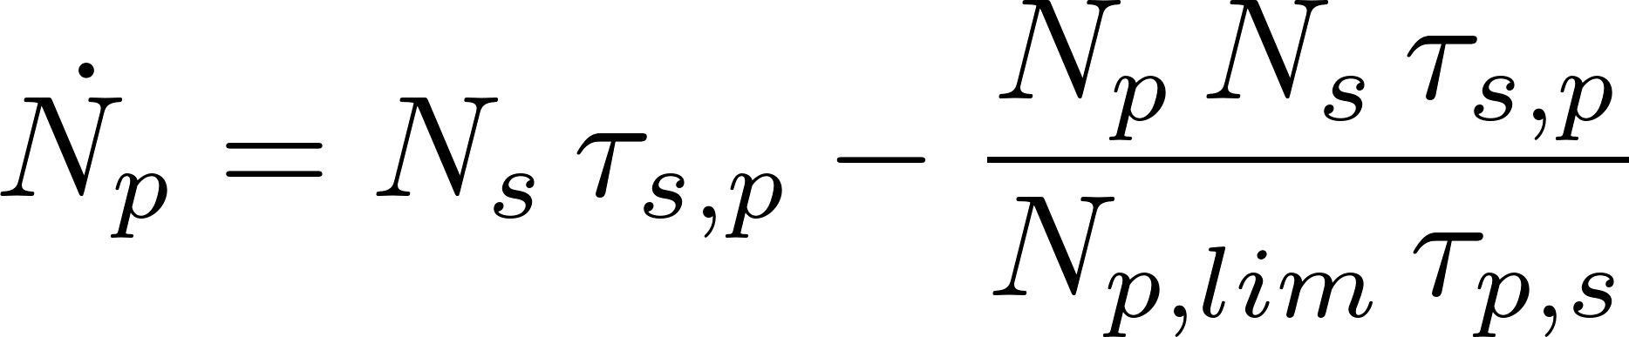
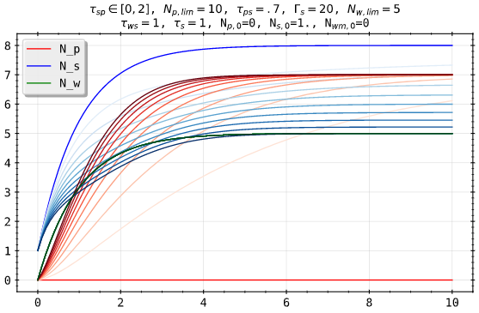
Impurity Seeding: Multi Chamber Model
three chamber model:
P
S
W
seeding
pumping

Slide 28
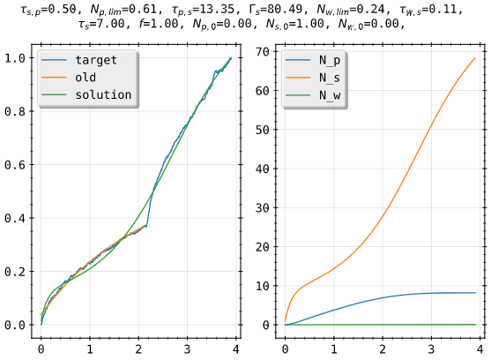
Impurity Seeding: Multi Chamber Model
three chamber model:
20180920.49

